Slide 1

Notes:
intro

Slide 2
WHAT IS WEB FIREWALL?
A web application firewall is a type of firewall designated to protect web applications. It continuously inspects HTTP traffic to detect and block malicious traffic and web application attacks. This can include access violations, API manipulations, advanced HTTP DDoS attacks, cookie poisoning, and many more.

Slide 3
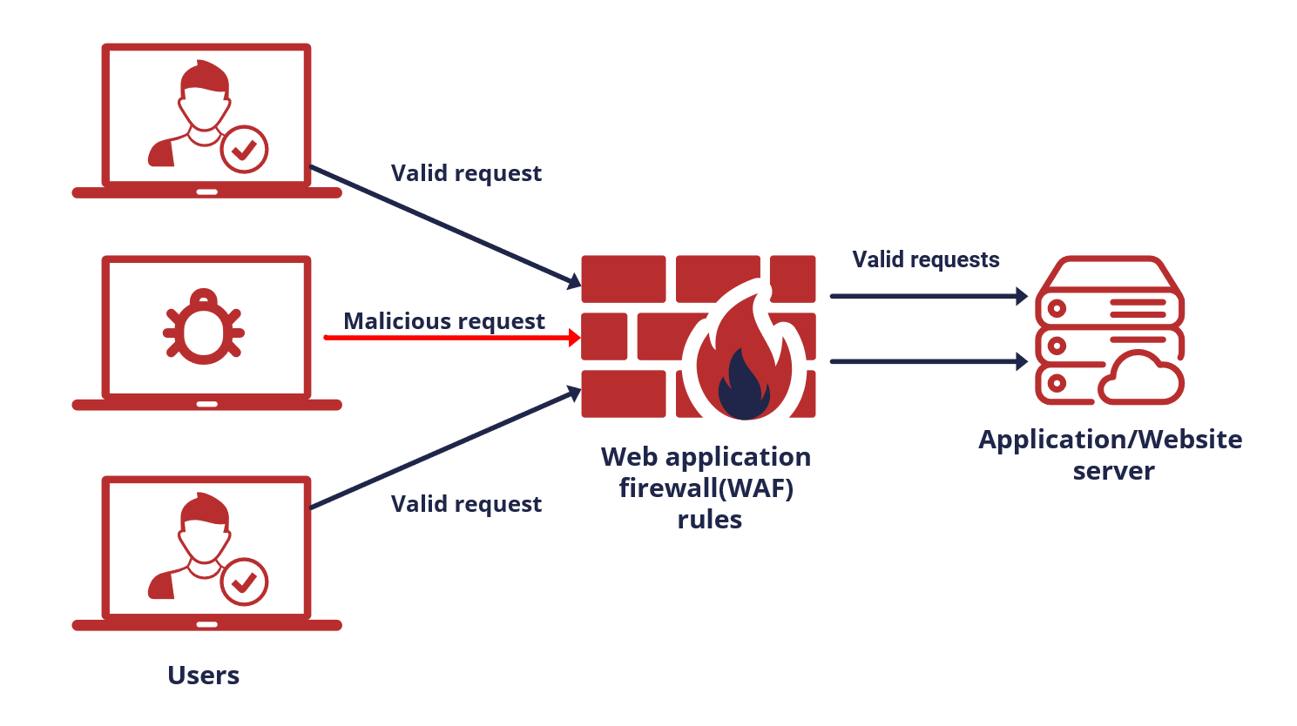

Slide 4

Functions of a Web Firewall
1. Intrusion Prevention: Detect and block malicious activities, such as hacking attempts and SQL injections.
2. Access Control: Authorize or deny access based on predefined rules or policies.
3. Web Content Filtering: Control the types of content that can be accessed, blocking potentially harmful or inappropriate content.
4. Traffic Monitoring: Monitor incoming and outgoing traffic to identify and prevent suspicious or harmful activities.

Slide 5
Types of Web Firewalls
1. Web Application Firewall (WAF): Protects individual web applications, analyzing HTTP traffic and blocking malicious requests.
2. Network Firewall: Protects the entire network infrastructure, examining all network traffic and filtering based on protocols, ports, and IP addresses.
3. Cloud-based Firewall: Deployed in the cloud, provides scalable protection, offloading the burden from on-premises infrastructure.

Slide 6

Benefits of Using a Web Firewall
1. Enhanced Security: Protects against various cyber threats, including hacking, data breaches, and malware infections.
2. Improved Performance: Optimizes web application performance by filtering out unnecessary traffic and reducing server load.
3. Access Control: Allows organizations to define and enforce access policies, ensuring authorized users only access the system.
4. Compliance: Helps meet industry or regulatory requirements by implementing necessary security measures.
5. Business Continuity: Mitigates the risk of downtime due to cyber attacks or unauthorized activities.

Slide 7

Conclusion
Web firewalls play a crucial role in protecting websites and web applications from a wide range of online threats.
By implementing a web firewall and following best practices, organizations can significantly enhance their online security and protect their sensitive data.

